Slide 1


AI for every developer
Gian Paolo Santopaolo
IBV Solutions - Switzerland
Microsoft Regional Director
Microsoft Windows Dev MVP
@gsantopaolo
Notes:
How many of you have developer background?
How many of you are familiar with .Net?
How many of you have already developed AI model?

Slide 2

Today’s Goals
What we are going to learn
02
Core DL Concepts, terminology, and algorithms
04
Develop our first DL application
01
Define what AI, ML and DL are
03
Ways of using AI

Slide 3
A note on the computational power
1995: 5M transistors on a chip
2005: 160M transistors on a single chip
2010: 1 Billion transistor
2015: 7.6 Billions transistors on a chip
2017: 15.2 Billions transistors on a chip
Notes:
1995: 5M transistors on a chip (the population of NYC at that time)
1995 was also the launch of the first Pentium and of Windows 95 everything changed
2005: 160M transistors on a single chip. This matches the population of the entire East Coast
Pentium 4 came out. Web was growing and there was the mobile around the corner
2010: 1 Billion transistor, post iPhone, post iPad, post connect world. We were doing gesture and voice recognition in our living room for 150 dollars!
2015: 7.6 Billions transistors on a chip, that’s a transistor for every man, woman and child on Earth
2017: In two years we filled up another planet
It took 30 year to fill up NYC and 10 years to fill up the entire world
This is the compute that’s changing the face of computation of ML and DL and driving it

Slide 4
A note on the computational power
1995: 5M transistors on a chip
2005: 160M transistors on a single chip
2010: 1 Billion transistor
2015: 7.6 Billions transistors on a chip
2017: 15.2 Billions transistors on a chip
Notes:
1995: 5M transistors on a chip (the population of NYC at that time)
1995 was also the launch of the first Pentium and of Windows 95 everything changed
2005: 160M transistors on a single chip. This matches the population of the entire East Coast
Pentium 4 came out. Web was growing and there was the mobile around the corner
2010: 1 Billion transistor, post iPhone, post iPad, post connect world. We were doing gesture and voice recognition in our living room for 150 dollars!
2015: 7.6 Billions transistors on a chip, that’s a transistor for every man, woman and child on Earth
2017: In two years we filled up another planet
It took 30 year to fill up NYC and 10 years to fill up the entire world
This is the compute that’s changing the face of computation of ML and DL and driving it

Slide 5
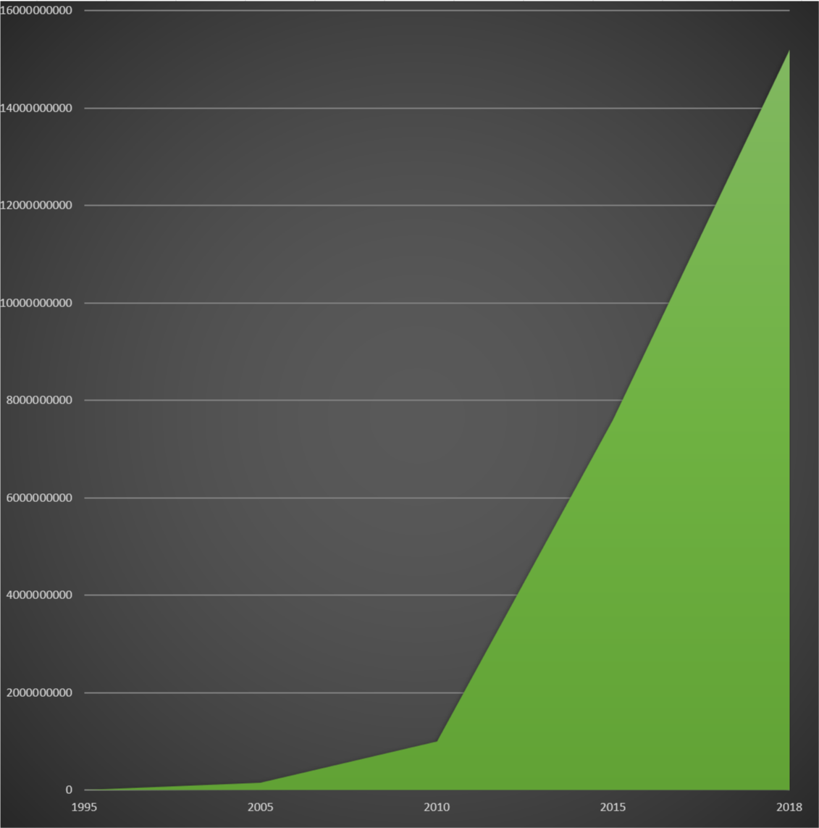
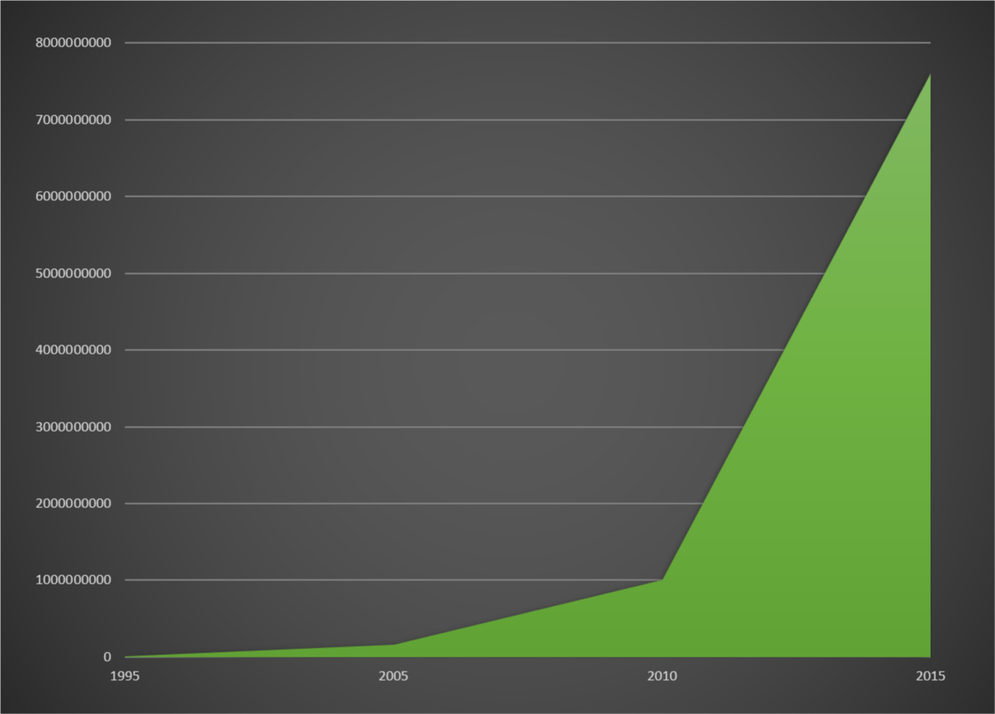
A note on the computational power
1995: 5M transistors on a chip
2005: 160M transistors on a single chip
2010: 1 Billion transistor
2015: 7.6 Billions transistors on a chip
2017: 15.2 Billions transistors on a chip
Notes:
1995: 5M transistors on a chip (the population of NYC at that time)
1995 was also the launch of the first Pentium and of Windows 95 everything changed
2005: 160M transistors on a single chip. This matches the population of the entire East Coast
Pentium 4 came out. Web was growing and there was the mobile around the corner
2010: 1 Billion transistor, post iPhone, post iPad, post connect world. We were doing gesture and voice recognition in our living room for 150 dollars!
2015: 7.6 Billions transistors on a chip, that’s a transistor for every man, woman and child on Earth
2017: In two years we filled up another planet
It took 30 year to fill up NYC and 10 years to fill up the entire world
This is the compute that’s changing the face of computation of ML and DL and driving it

Slide 6

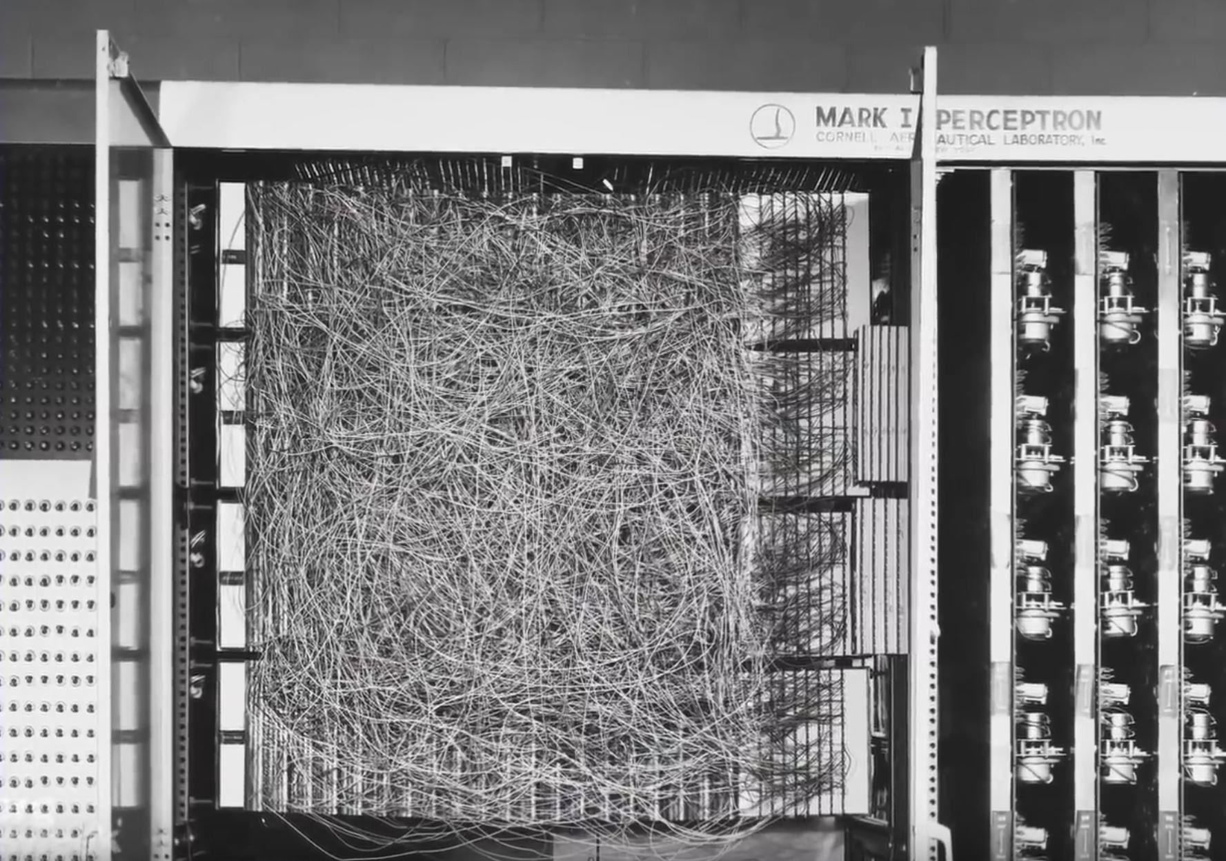
01 Define what AI, ML and DL are
Artificial Intelligence
Machine Learning
Deep Learning
1943
1959
2012
1943 - the first work that is now generally recognized as AI was McCullouch and Pitts' formal design for Turing-complete "artificial neurons".
1959 - The name machine learning was coined by Arthur Samuel. Evolved from the study of pattern recognition and computational learning theory in artificial intelligence, machine learning explores the study and construction of algorithms that can learn from and make predictions on data
2012 – A group of scientist built a network of 16,000 computer processors with one billion connectors and let it browse YouTube looking for cats. The "brain" simulation was exposed to 10 million randomly selected YouTube video thumbnails over the course of three days and, after being presented with a list of 20,000 different items, it began to recognize pictures of cats using a "deep learning" algorithm

Slide 7
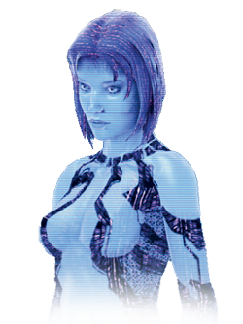

Artificial Intelligence (AI) is the science of making things smart. Can be defined as:
Human Intelligence exhibited by machines
A board term of getting computers to perform human tasks. The scope of AI is disputed and constantly changing over time.

Slide 8

Artificial Intelligence – the state of the art
System Implemented today are a form of narrow AI
A system that can do just one (or a few) defined things as well or better than humans
Like recognize object / detect a CC fraud in real time

Slide 9
Machine Learning
Machine Learning (ML) can be generally defined:
“An approach to achieve artificial intelligence through systems that can get better the more you run them”
ML involves teaching a computer to recognize patterns by example,
rather than programming it with specific rules.
Patterns can be found within data.
ML is about creating algorithms (or a set of rules) that learn complex function (or pattern) from data and make prediction on it

Slide 10
How ML works
ML is about predicting stuff and it is intelligent because:
It takes some data (to train the system)
Learns patterns from this data
Classifies new data it has not seen before for a best guess
Classification is based on knowledge gained in the learning process
Traditional programming
Write a computer program with explicit rules to follow
If email contains “Viagra”
then mark as spam
If email contains ….
If email contains ….
Machine Learning Programs
Write a computer program that learn from examples
Try to classify some emails (training)
Apply learned model to classify

Slide 11
Deep Learning
Deep Learning (DL) can be generally defined:
“A technique for implementing ML”
A DL technique is Deep Neural Networks (DNNs)
DL is the context of DNNs
DNNs is where the code you write is arranged in layers that loosely mimic the brain

Slide 12
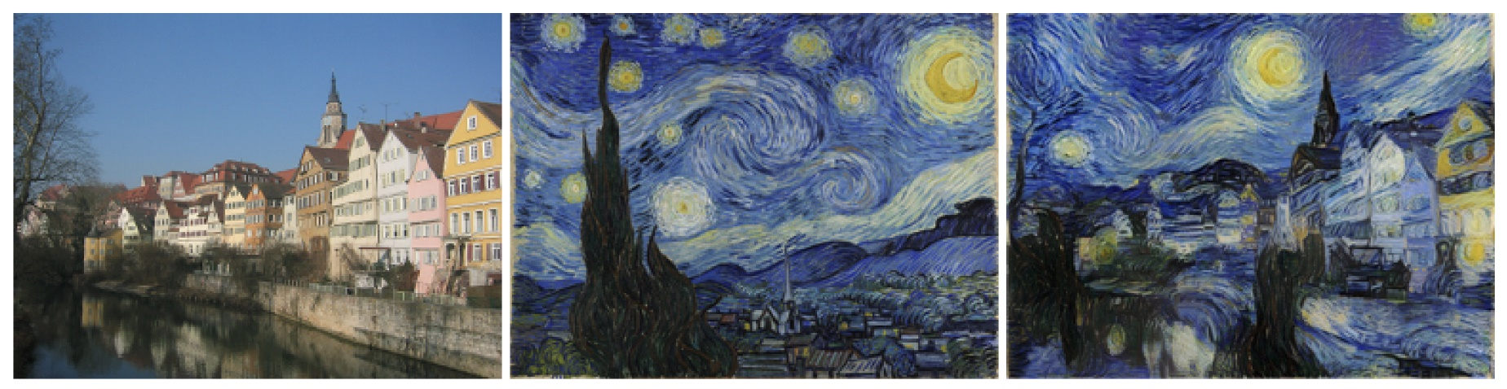
AI Common Use Case
Object recognition
Speech recognition
Natural Language Processing
Creative (eg style transfer)
Prediction
Data Security
Financial (trading / fraud detection)
Healthcare
Marketing (custom ads/recommendations)
Online search
Smart Cars

Slide 13

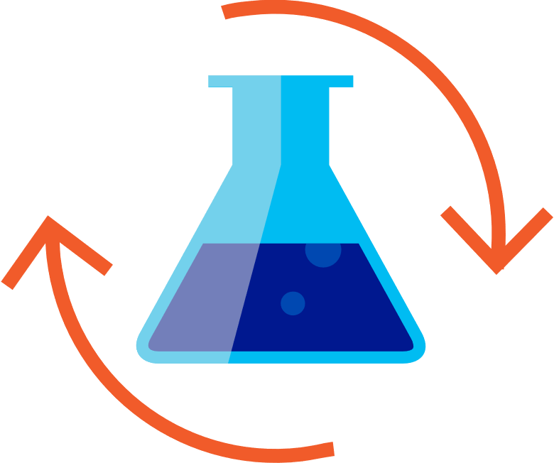

02. Core DL Concepts, Terminology and Algorithms
AI development lifecycle
Prepare Data
Build & Train
Deploy and use your model on client and server
Using…
Visual Studio 2017 with AI Tools
Visual Studio 2017 and ML.Net
Train on Azure

Slide 14
Features and Attributes
Identify attributes of the things you are trying to classify
If I’m trying to classify fruit maybe is color and weight
Dimension usually refers to the number of attributes
Feature (or Attribute) is one particular "type of data" in your datapoints
Each datapoint (like fruit) contains many different attributes (like color, weight, shape)

Slide 15
The data challenge
Once you know features to use then the challenge is to find enough data to train the model
Imagine you need to recognize cats. You may need 10K sample images of cats if you want to get a good result
Data is any sort of features you need to classify your problem: it can be database rows, sound sample, video samples, text and so on

Slide 16
ML knowledge
An ML system cannot predict stuff it does not know about
Let’s image you train an ML system with a dataset containing features: animal name, number of legs, color, weight :
Dog, 4, black, 10Kg
Chicken, 2, orange, 5Kg
If you now ask the model to evaluate the row:
Cow, 4, black, 200Kg
The model will predict “Dog” because it only knows about dogs and chickens and it got the nearest match

Slide 17
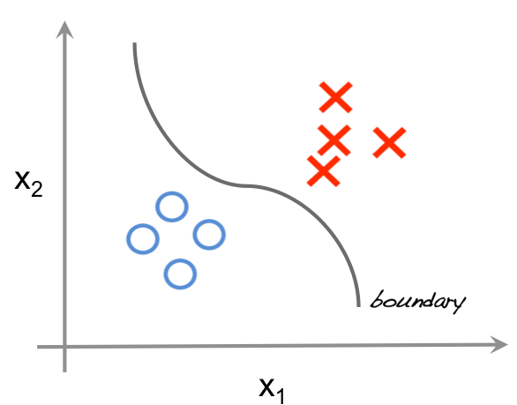
Ways to train a model – Supervised Learning
When the ML is trained with data, and those data are labelled
LABEL, number of legs, color, weight :
Dog, 4, black, 10Kg
Chicken, 2, orange, 5Kg
Give three inputs (number of legs, color, weight) we are telling the system what output label we do expect
ML uses this data to predict future unseen data

Slide 18
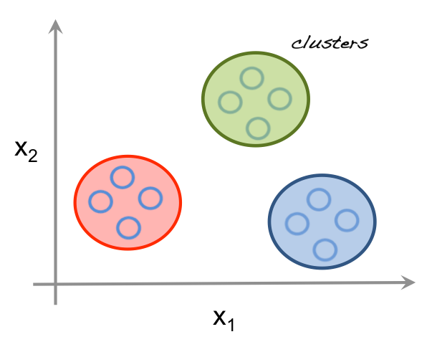
Ways to train a model – Unsupervised Learning
ML learns from an unlabeled data set
Imagine we have some points on a graph representing 3 different things
ML must realize itself there are 3 distinct clusters and categorize them
This is tricky, because the number of clusters may not be known in advance, so it has to take a best guess.
Sometimes the clusters are not as clear as the ones shown here

Slide 19
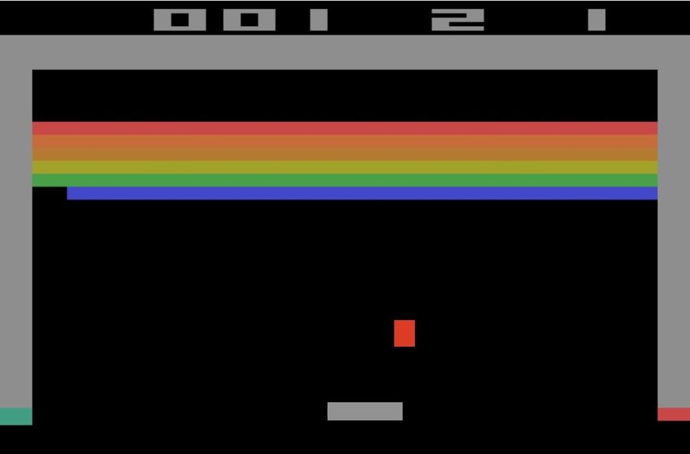
Ways to train a model – Reinforcement Learning
ML learns by playing the game millions of times.
ML is rewarded when it makes a good move
When it loses, we give him no (or negative reward)
Overtime ML learns to maximize reward without the human explicitly telling the rules. It can lead to better than human performance when it finds paths that no one thought of doing before.

Slide 20
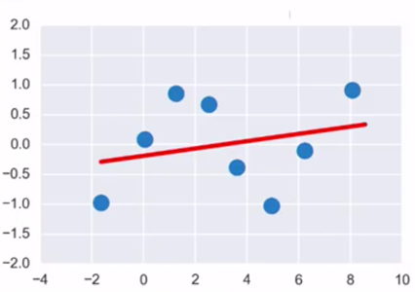
How the model training works
There are many ways a ML can learn pattern to classify data
In this example we use a line to divide two clusters.
We can predict future data saying anything above the line is owned by one cluster and anything below the line is owned by the other cluster

Slide 21
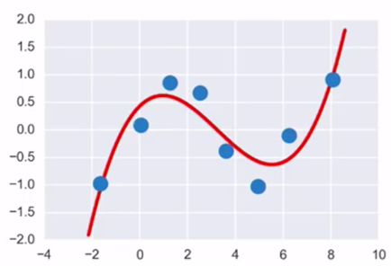
How the model training works
Cubic curve
Instead of a straight line we may use a cubic curve to identify clusters.
That way the ML will predict future points it has not seen before by understanding in witch area the point belongs

Slide 22
Neural Networks
Our brain consists of 86 billion or so interconnected neurons.
Each neuron responds to certain stimuli and passes output to another.
There may be a bunch of them dedicated to recognize cats (some for fur, eyes, whiskers, etc) each having a different weighting (based on how important the feature is) to the overall contribution. If all of those fire, your brain tells you saw a cat
In ML, Artificial Neural Networks (loosely modelled to the brain) are used to calculate the probabilities for features they are trained to look for.

Slide 23
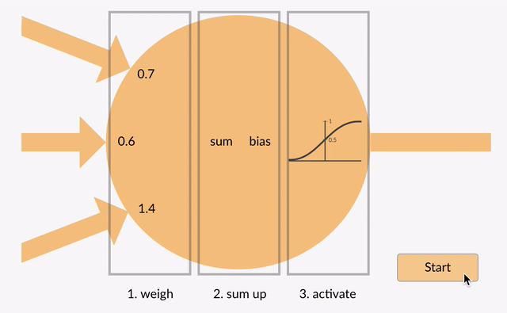
Artificial Neuron
The 3 arrows correspond to the 3 inputs coming into the network
Values [0.7,0.6,1.4] are the weights assigned to the corresponding input
Inputs get multiplied with their respective weights and their sum is taken.
Consider 3 inputs as x1,x2,x3.
Consider 3 weights be w1,w2,w3
Sum = x1w1 + x2w2+x3w3.
i.e. Sum=x1(0.7) + x2(0.6) + x3(1.4)
After summing we add bias to the sum obtained.
This Bias is just a constant number say 1 which is added for scaling purposes.
NewSum=x1(0.7) + x2(0.6) + x3(1.4) + bias
Animation and definition courtesy of becominghuman.ai
It’s not necessary to add bias but it is a good practice as it speeds up the process.
After adding bias, we reach at threshold step. If the new sum calculated is above the threshold value the neuron gets excited and it passes out the output.
If it doesn’t get excited it won’t pass on the output

Slide 24
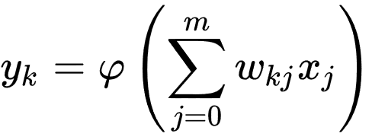
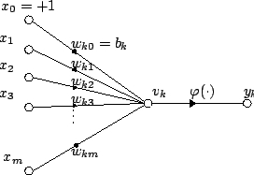
Artificial Neuron – the math behind
For a given artificial neuron, let there be m + 1 inputs with signals x₀ through x_{m} and weights w₀ through w_{m}. Usually, the x₀ input is assigned the value +1, which makes it a bias input with w_{k0} = b_{k}. This leaves only m actual inputs to the neuron: from x₁ to x_{m}
The output of the kth neuron is:
Where (phi) is the transfer function
The output is analogous to the axon of a biological neuron, and its value propagates to the input of the next layer, through a synapse. It may also exit the system, possibly as part of an output vector.
It has no learning process as such. Its transfer function weights are calculated and threshold value are predetermined.
Source Wikipedia

Slide 25

Artificial Neuron - Activation Functions
ReLu is the most used one
sigmoid/tanh rarely

Slide 26
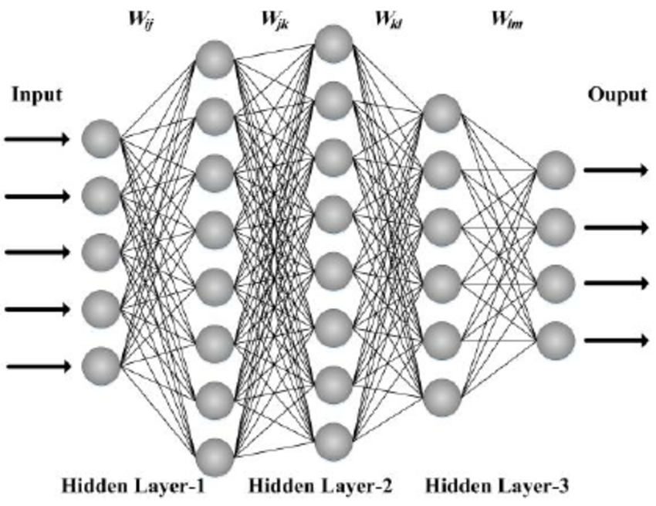
Multi layer neuron
Stacking up many Artificial Neuron help us to create Intelligent Systems

Slide 27
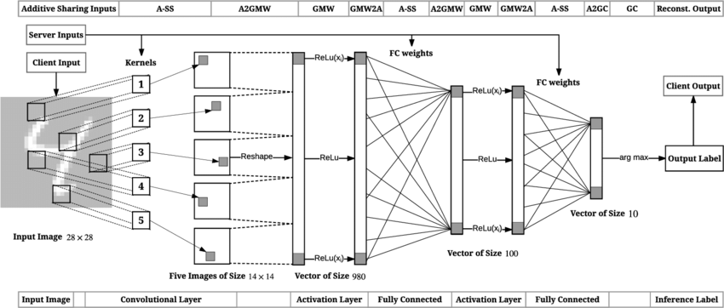
Deep Neural Network
A Deep Neural Network (DNN) simply consists of many “hidden layers” between the input and the output.
Each layer can learn from the one before.
Hidden layer are usually of a lower dimension so the can generalize better and not overfit input data.
Middle layers can learn features of for features.
For example bunches of edges can lead to “face parts” witch leads to “faces”

Slide 28
DN comes in two very popular flavors
CNN
Convolutional Neural Networks
Vision
RNN
Recurrent Neural Networks
Language
The two most popular types of Deep Networks

Slide 29
Common ML Output Types
Regression
Predict numerical values
(e.g. price of house)
Classification
On of n labels..
Cat, dog, human
Clustering
Most similar other examples
(e.g. related products on Amazon)
Sequence Prediction
What comes next?
Given 1,2,3,4,5
Predict 6

Slide 30
04. Develop our first DL application
Tools
Visual Studio Tools For AI
Getting Started with Visual Studio Tools for AI: https://channel9.msdn.com/events/Build/2018/THR3129
Sample repo: https://github.com/Microsoft/samples-for-ai
Win.ML
Introducing ML.Net: https://channel9.msdn.com/Events/Build/2018/BRK3203
Samples repo: https://github.com/dotnet/machinelearning-samples

Slide 31

03. Three ways of using AI
Option 1 – Easy
AI as Service

Slide 32

cognitive services
Infuse your apps, websites and bots with intelligent algorithms to see, hear, speak, understand and interpret your user needs through natural methods of communication

Slide 33
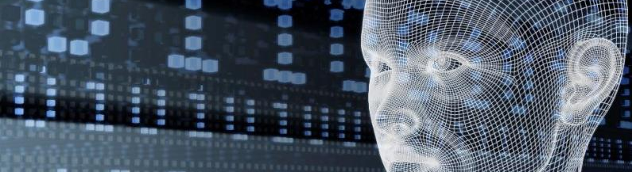





Microsoft Cognitive Services updates
Vision
Speech
Language
Knowledge
Search
Video Indexer
Speaker Recognition
Text Analytics
QnA Maker
Bing Entity Search
Computer Vision
Bing Speech
Bing Spell Check
Bing Autosuggest
Face
Translator Speech
Translator Text
Bing Search
Emotion
Unified Speech
Bing Statistics add-in
Content Moderator
Bing Visual Search

Slide 34





Pre-built ML Models (Azure Cognitive Services)
e.g. Sentiment Analysis using Azure Cognitive Services
TextAnalyticsAPI client = new TextAnalyticsAPI();
client.AzureRegion = AzureRegions.Westus;
client.SubscriptionKey = "1bf33391DeadFish"; client.Sentiment(
new MultiLanguageBatchInput(
new List<MultiLanguageInput>()
{
new MultiLanguageInput("en","0", "This is a great movie")
}));
Vision
Speech
Language
Labs
Knowledge
Search
96% positive
Consume (C#, VB, F#)

Slide 35
03. Three ways of using AI
Option 2 – Still easy, but more work
Custom Service

Slide 36
Microsoft Cognitive Services updates
Vision
Speech
Language
Knowledge
Search
Video Indexer
Speaker Recognition
Text Analytics
QnA Maker
Bing Entity Search
Computer Vision
Bing Speech
Bing Spell Check
Bing Autosuggest
Face
Translator Speech
Translator Text
Bing Search
Emotion
Unified Speech
Bing Statistics add-in
Content Moderator
Bing Visual Search
Customization
Custom Vision
Custom Speech
Language Understanding (LUIS)
Custom Decision
Bing Custom Search

Slide 37
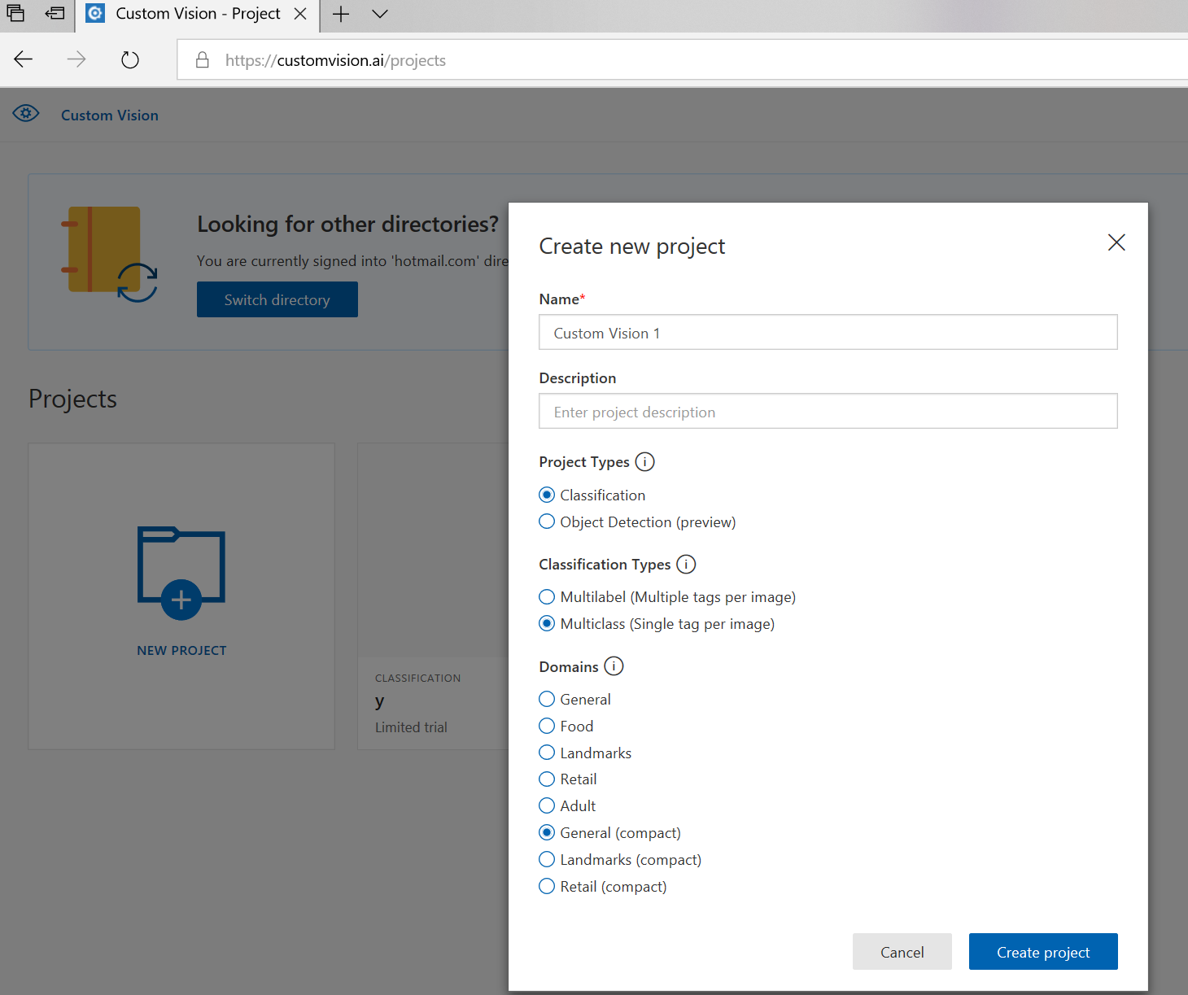
Using Custom Cognitive Services
Customvision.ai
Create new project

Slide 38
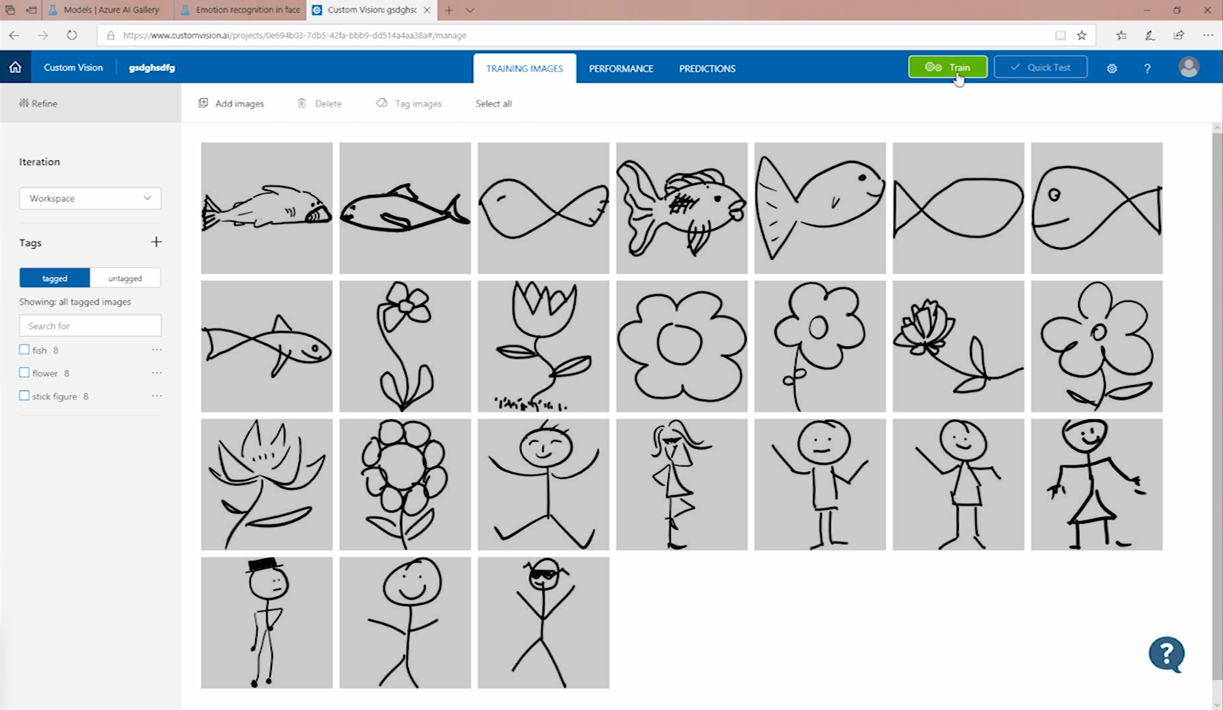
Using Custom Cognitive Services
Add your sample data
Train the model

Slide 39
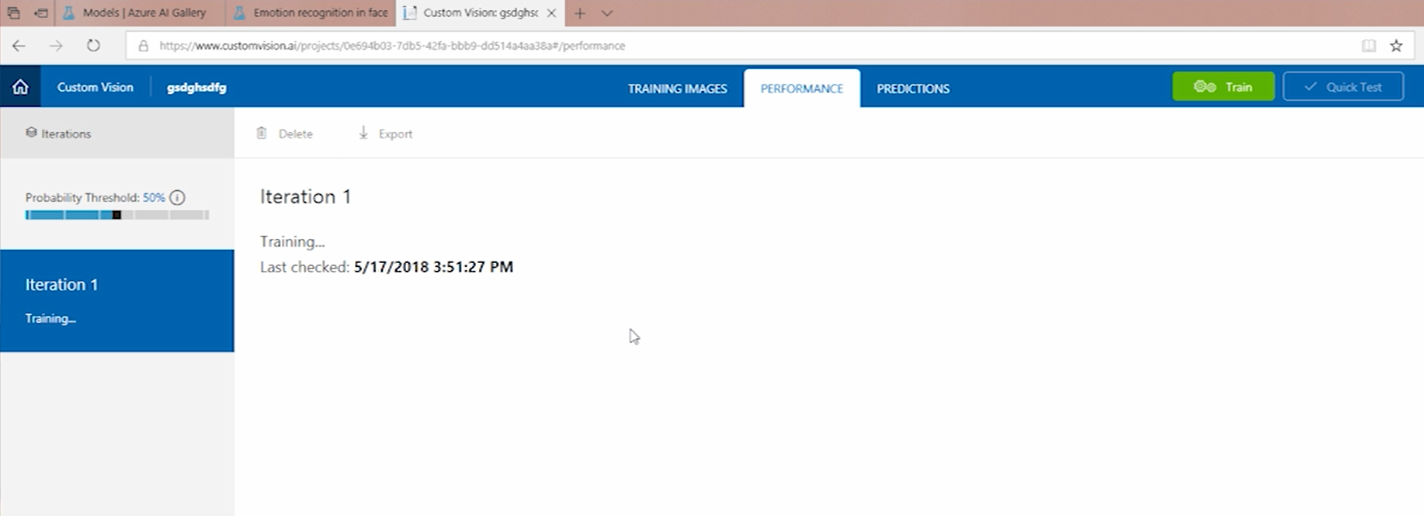
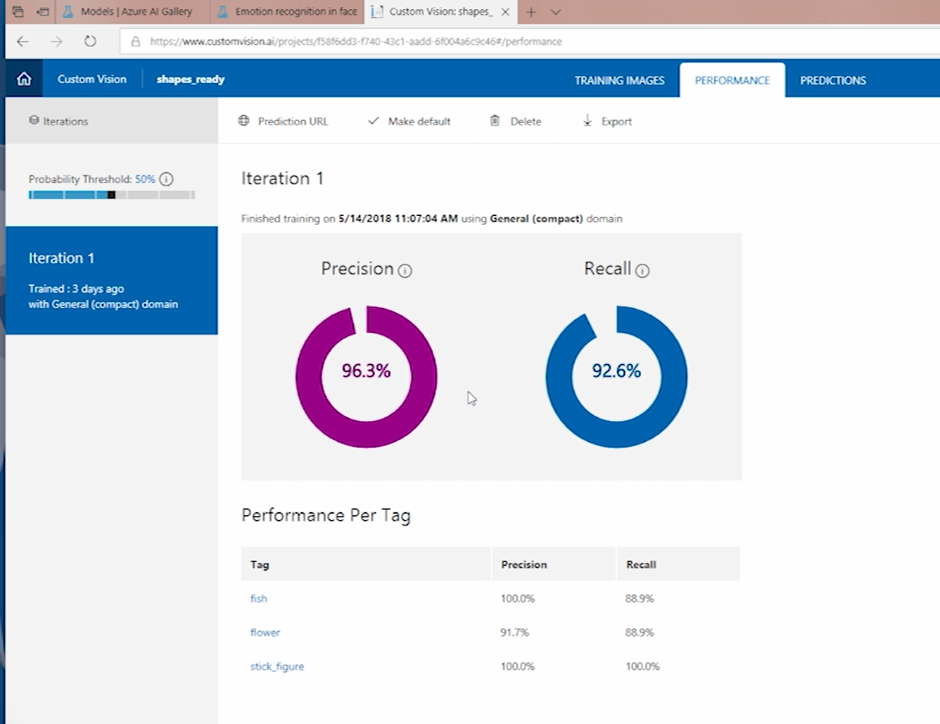
Using Custom Cognitive Services
Verify the result of your trained model until you are satisficed

Slide 40
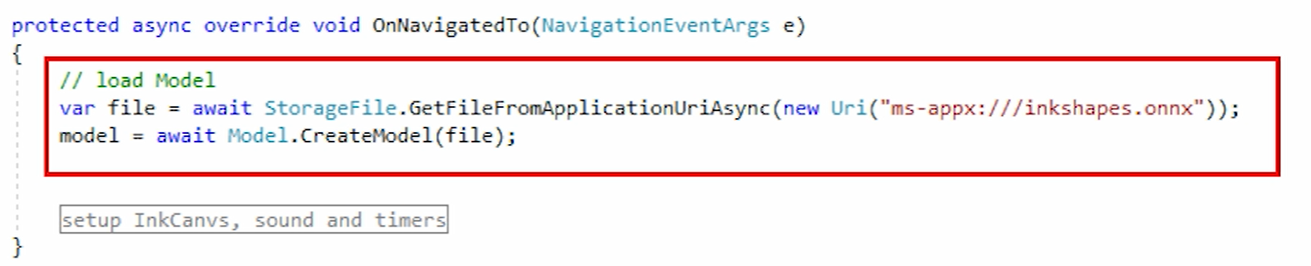
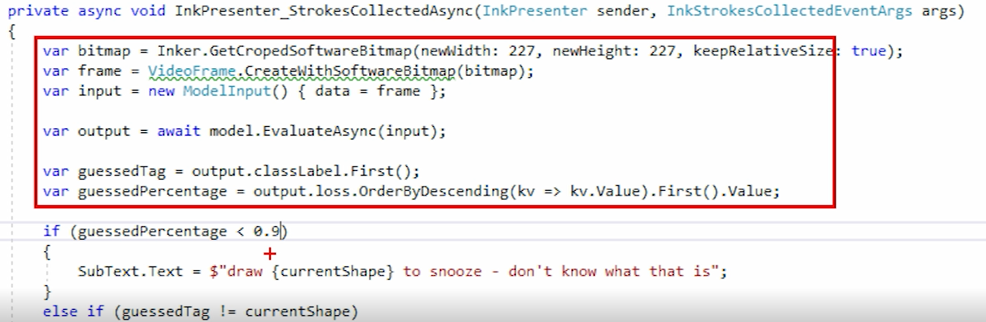
Using Custom Cognitive Services
Import the model in your project and load it
Evaluate against your data

Slide 41
Windows ML solves three problems for you
Developers can focus on their data and their scenarios, using Windows ML for model evaluation
Enables using ML models trained with a diverse set of toolkits
Hardware acceleration gets fast evaluation results across the diversity of the entire Windows device ecosystem.
UWP App
Win32 App
WinML UWP API
WinML Win32 API
WinML Runtime
Model Inference Engine
DirectML
Direct3D
CPU
GPU

Slide 42


Slide 43
How do I get ONNX models to use in my application?
Azure Machine Learning Services gives you an end-to-end solution to prepare data, and train your model in the Cloud.
WinMLTools converts existing models from CoreML, scikit-learn, LIBSVM, and XGBoost
Azure Custom Vision makes it easy to create your own image models - https://customvision.ai/
Azure AI Gallery curates models for use with Windows ML - https://gallery.azure.ai/models

Slide 44
03. Three ways of using AI
Option 3 – Hands will be dirtied
Coding your AI

Slide 45
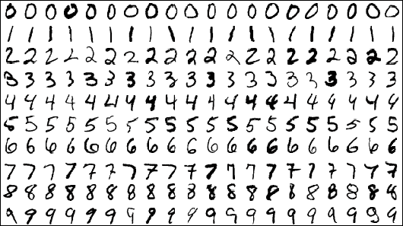
Datasets
MNIST database of hand-written digits (Modified) National Institute of Standards and Technology
http://yann.lecun.com/exdb/mnist/

Slide 46
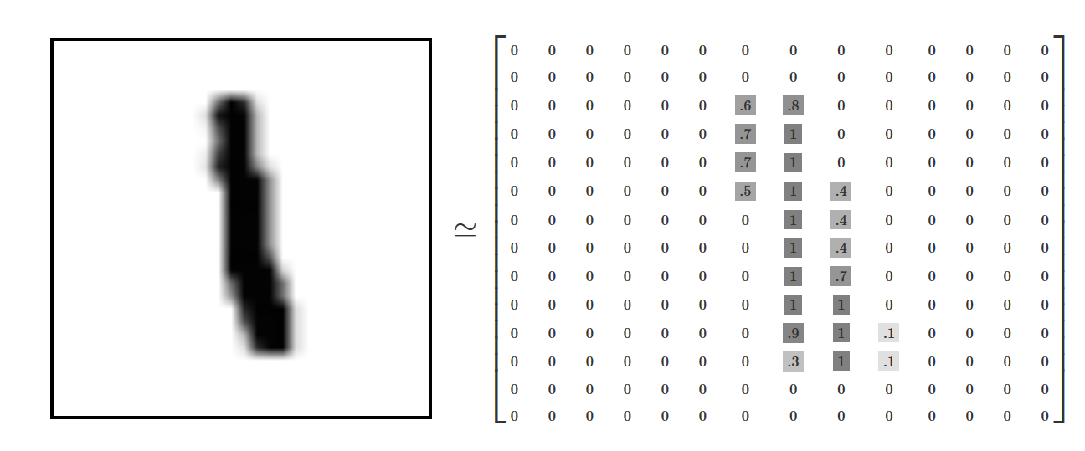





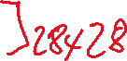



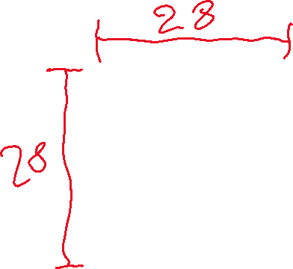


Slide 47

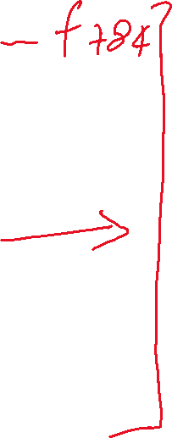






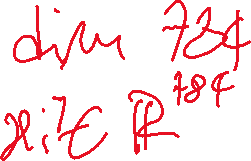


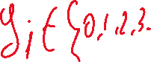

Slide 48
04. Develop our first DL application

Slide 49
Resources
Make Your Own Neural Network - Rashid, Tariq
Deep Learning with Python - Chollet, Francois
Yaser S. Abu-Mostafa – Learning from data https://www.amazon.com/Learning-Data-Yaser-S-Abu-Mostafa/dp/1600490069 (inside the book instruction to access whole semester course gave by prof. Yaser S. Abu-Mostafa at California Institute of Technology)
Andrew Glassner – Deep Learning: A crash Course https://www.youtube.com/watch?v=r0Ogt-q956I
MIT - Massachusetts Institute of Technology – Professional Certificate Program in Machine Learning & Artificial Intelligence
Microsoft’s official AI site for devs azure.com/ai
Microsoft’s AI School https://aischool.microsoft.com/en-us/learning-paths
Rick Barraza – AI for Everyone! https://www.youtube.com/watch?v=xhp1m9thnbE
Jason Mayers – Machine Learning in 45 Minutes https://www.youtube.com/watch?v=X4I9QmcSEYo
Chris Lauren – Seth Juarez - Demystifying Machine and Deep Learning for Developers https://www.youtube.com/watch?v=cU7Wq5k8u-U
Introducing ML.NET https://www.youtube.com/watch?v=OhCysVU5RDA
ONNX https://onnx.ai/
ONNX Model Zoo https://github.com/onnx/models
ONNX models for WinML https://docs.microsoft.com/en-us/windows/ai/get-onnx-model
Azure AI Gallery curates models for use with Windows ML - https://gallery.azure.ai/models
Ml.Net Samples https://github.com/dotnet/machinelearning-samples
CH9 – AI Show https://channel9.msdn.com/Shows/AI-Show
The MNIST Database http://yann.lecun.com/exdb/mnist/
Kaggle Datasets database https://www.kaggle.com/datasets
Getting started with TensorFlow https://tf.wiki/en/basic.html
Getting Started with Visual Studio Tools for AI https://www.youtube.com/watch?v=LLW_0MQoQ1g
Visual Studio Tools For AI https://docs.microsoft.com/en-us/visualstudio/ai/?view=vs-2017
Visual Studio Tools For AI GitHub Sample repo https://github.com/Microsoft/samples-for-ai
CNTK Examples https://docs.microsoft.com/en-us/cognitive-toolkit/Examples
TensorFlow model zoo https://github.com/tensorflow/models/blob/master/research/object_detection/g3doc/detection_model_zoo.md
Cafee model zoo https://github.com/BVLC/caffe/wiki/Model-Zoo
Christopher Olah’s blog about DL http://colah.github.io/

Slide 50
Credits
Special thanks to the following people and groups that contributed inspiration, ideas or support for this ever-evolving talk / workshop:
https://twitter.com/jason_mayes
https://twitter.com/rickbarraza
https://twitter.com/sethjuarez
https://twitter.com/ankitasthana86
https://twitter.com/ch402
http://www.asimovinstitute.org/

Slide 51
Thank You
Got questions?
Gian Paolo Santopaolo
IBV Solutions
gp@ibv.ch
@gsantopaolo

